Slide 1



Smart UPMC
Health Insurance Evaluation System
Team 9
Notes:
Hello everyone. Today I am going to introduce you our innovative solution for UPMC- SMART UPMC health evaluation system.

Slide 2





UPMC’s Requirement
Healthcare
Insurance cost
UPMC
Requirement
Traditional Evaluation
Smart UPMC System
Notes:
So why does UPMC need this solution? Health care expenditures has doubled many times during these years, which leads to the growing cost of health insurance in U.S. This kind of situation not only cased by aging of population, but also by numerous diseases caused by modern unhealthy lifestyle. In order to deal with this situation, UPMC wants to offer discounts to those people who have healthy lifestyle based on evaluations. But the problem is how to collect data and evaluate the lifestyles? Traditional survey way is time-consuming and may gather false information about lifestyle. So to solve this problem, we recommend the UPMC to choose our solution based on cloud computing services.

Slide 3
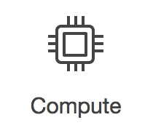
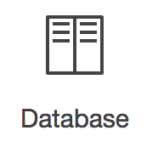
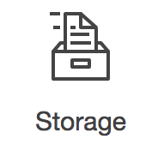





With Cloud Computing
Serverless
Economies
of Scale
Speed
scalability
Notes:
INTROUDTION: So what is cloud computing: Cloud Computing is a kind of compute service and resources provided by companies like Amazon, and shared by everyone. In the cloud platform, we can use compute services ,scale database or back up data over cloud platform. It’s economic and efficient , because you can access as many resources as you need on the serverless cloud platform, almost instantly, and only pay for what you use. Companies like UPMC health insurance can save at least 30% IT investment from cloud computing.

Slide 4









Tools & Services
Object Recognition APIs
Amazon API Gateway
AWS
Lambda
Amazon S3
Amazon EC2
Google Vision
Amazon Rekognition
MS Azure Computer Vision
Wearable Camera
Notes:
So what tools are we going use for this solution? Firstly, as for the hard devices, a lightweight wearable camera will be attached to the client’s glasses or wristbands. Hence, the cameras will capture images of the client’s diets and exercises. As for the software, the system will mainly use the amazon web services. We will use api gateway to call lambda which runs functions, use s3 as storage and use ec2 to launch virtual machine. As for the there object recognition APIS, they are used for photo analysis and return food labels.

Slide 5
Tools & Services Comparison
 | AWS Lambda Function | Google Cloud Function | MS Azure Cloud Function
Pricing | 1M requests for free, then $0.20/1M invocations, plus $0.00001667/GB-sec | 1M requests for free, then $0.40/1M invocations, plus $0.00000231/GB-sec | 1M requests for free, then $0.20/1M invocations, plus $0.000016/GB-sec
Event-driven | S3, SNS, DynamoDB, Kinesis, CloudWatch, API Gateway, EC2, etc. | Cloud Storage Object Change Notifications | Service Bus Topic, Timer triggers, Http
Supported languages | JavaScript, Python, Java, Ruby, C#, Go, Node.js, PHP | Only JAVA Script | C#, JavaScript, F#, Python, Node.js
Notes:
Cloud function is an very important part in our system. So why we choose AWS lambda functions? Actually they have some shared merits like they are all auto-scalable . But particularly, the AWS lambda has the lowest pricing and much more supported languages and related services like services like S3 storage, API gateway, EC2, and etc . So It is more convenient for developers to use than the other two functions.

Slide 6



AWS API GATEWAY
Copy images to
the upload bucket
Send requests to three APIs
Invoke a Lambda Function
Returns labels
USER BUCKET
UPLOAD S3 BUCKET
AWS LAMBDA
Lambda calculates image scores and stores in a S3 bucket
OBJECT RECOGNITION APIs
AWS API GATEWAY
EC2 Instance
J2EE Web App sends requests to Lambda
Invoke a Lambda Function
Lambda calculates and returns overall score to the web
J2EE WEB APP
AWS LAMBDA
SCORES S3 BUCKET
Notes:
So here shows our system’s architecture: As you can see, first we copy images to the upload s3 bucket. After that the S3 bucket with API gateway will invoke a lambda functions to send requests to 3 APIs . Then the 3 APIs will analyze the images and return labels like: food or nonfood, bread or vegetables. The system will store all the image scores in another S3 bucket and invoke another lambda to calculate the user’s overall scores. And when the user clicks to see the analysis, the web page will sends request to lambda by API and lambda will return the overall scores to the user along with charts.

Slide 7




System Evaluation
Scalability
Accuracy
Horizontal scaling
Load balancer
97% accuracy
Different weighting factors in 3 APIs
Consider drugs, cigarette and alcohol;
Performance
Cost
Multithreading
About 500 ms per pic
Demo: cost less than $10
Launch the system with 1M users: $213K
Notes:
Our system has advantages in at least 4 aspects. First it’s easy to scale .even if millions of users use our system, the system can automatically invoke horizontal scaling to add more virtual machines and lambda functions in a few minutes. Also, it is convenient to launch load balancer to disperse flow in our system during the peak-hour.
As for the accuracy, based on our our test, our system can reach 97% accuracy during the regular test. To improve accuracy, we gave different weighting factor to 3 APIs. And we also take drug, cigarette and alcohol into scores calculation, these three will all mark down the health scores in different degree.
As for our performance, by implementing Multithreading, our system can process I picture in 500 ms; Meanwhile, it only cost no more than $10 for us to finish this test system, which is high-efficient and economic.

Slide 8
Cost Estimation (1 million users/per month)
AWS
APIs
Labor
LAMBDA
$213
Amazon Rekognition
$58562
Maintaining
$1500
S3 Storage
$1,125
S3 Request
Google Vision
$92500
Training
$213K
$880
$8.6
API Gateway
$7
Azure Computer Vision
$1508.6
$58500
EC2
$31104
$33329
$209562
Notes:
As we talk about the cost, this cost estimation is based on 1 millions users per month. As you can see, It consists 3 major parts: cost of AWS,,APIS and labor cost. the total cost for 1 million users is about 210 thousand dollars. About 0.2 dollars per customers, which is a great deal.

Slide 9
Cost Estimation (Scale by 1,000 users)
AWS
APIs
Labor
LAMBDA
$0
Amazon Rekognition
$90
Maintaining
$0
S3 Storage
$1.1
Google Vision
$133
$15K
S3 Request
$0.88
Training
$4.3
API Gateway
$3.5
Azure Computer Vision
$90
$4.3
EC2
$15298
$15303
$313.5
Notes:
This second cost estimation is based on the condition that the system attracts 1000 new users later. As you can see that it’s still consists of the exact same parts and the total cost of 1000 users is about $15000.

Slide 10


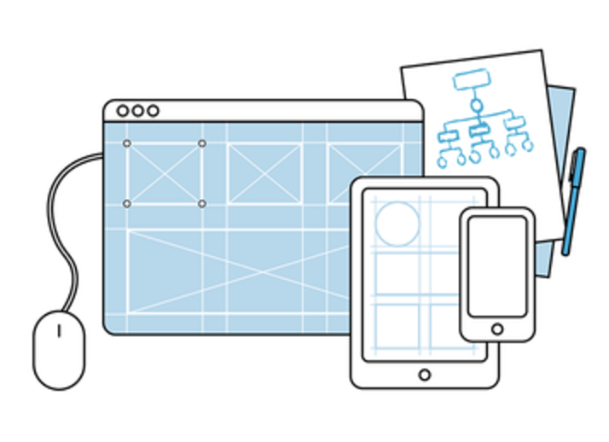
Incoming improvement
More accurate
Nutrition APIs
Expand dictionary
Shorter processing Time
More Professional UI
UI with Multi-function
Notes:
Due to the budget or time limitations, our solution is still Imperfect. For instance, our solution might be lack of accuracy when it comes to complicated food, like lunch box can not calculate the food quantity and calories. And it’s possible to achieve shorter processing time and a more professional UI. But if we have more time and budge, we will solve these problems by like adding dietary balance and calorie measure APIs ,training more data to our to expand our dictionary and spending more time on UI design to build more user-friendly interface.

Slide 11


11
Notes:
UPMC health insurance provides life changing insurance and service, I believe that with our SMART health evaluation system, UPMC health insurance will attract more prospective customers and make another big achievement. Thank you for listening.

